Slide 1
Introduction to Machine Learning Week I
Lecturer : Mr. Hel Chanthan
Student : Chek Nita

Slide 2
Outline
What is Machine learning ?
How does it works ?
Machine learning techniques
Pythons Packages for Machine Learning
Supervised and Unsupervised
Differences between supervised and unsupervised

Slide 3
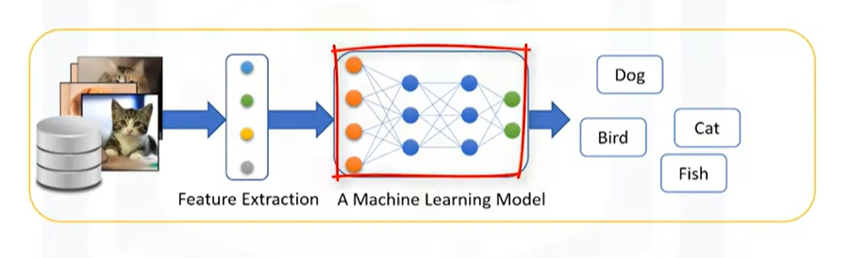
Machine Learning
What is Machine Learning ?
Machine Learning is the subfield of computer science that gives “computers the ability to learn without being explicitly programmed.
How does it work?

Slide 4
Machine Learning
Machine Learning techniques :
Regression/Estimation
Predicting continuous values
Classification
Prediction the item class/ category of a case
Clustering
Finding the structure of data / summarization
Associations
Finding item that co-occur

Slide 5
Machine Learning
Anomaly detection
Discovering abnormal and unusual case
Sequence mining
Predict next events
Dimension Reduction
Reducing the size of data
Recommendation systems
Recommending items

Slide 6
Python For Machine Learning
Python is a popular and powerful general purpose programming language that recently emerged as the preferred language energy data scientists.
These are python packages that easy to use for machine learning :
Numpy : a math library to work with N-dimensional array in python , suitable for working with arrays dictionaries , functions , data types , working with image
SciPy : a collection of numerical algorithms and domain specific toolboxes , suitable for signal processing optimization , statistics and much more.
Matplotlib : provides 2D plotting and 3D plotting.
Panda library
Scikit learn

Slide 7
Supervised and Unsupervised
Supervised is mean to observe , direct the execution of tasks , project or activity
Supervised techniques :
Classification : is the process of predicting a discrete class label, or category.
Regression : is the process of predicting a continuous value as opposed to predicting a categorical value in classification.
Unsupervised means that the model will works on its own to discover information that may not visible to human eyes.
Unsupervised techniques :
Clustering : is grouping of data points or objects that are somehow similar by :
Discovering structure
Summarization
Anomaly detection

Slide 8
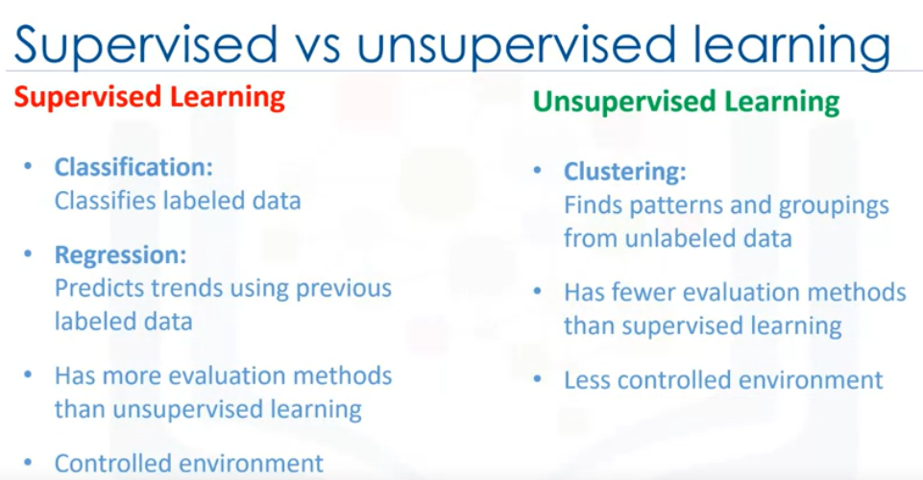
Differences

